Slide 1
Baltimore County: Covid, Crime and Unemployment
Corina Geier

Slide 2
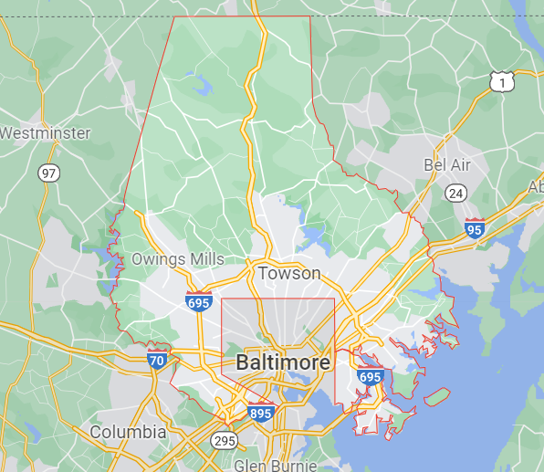
Motivation
Goal: Understand the relationship between:
Covid Infection Rate
Unemployment Rate
Crime Reports
Notes:
My goal was to understand the relationship between covid infection rate, the labor industry and crime reportings. I was interested in unemployment rate and crime reports because I thought they might also have a relationship as there have been studies that have shown a positive effect of unemployment on property crime rates and I wondered if covid infection was correlated with these two factors.

Slide 3
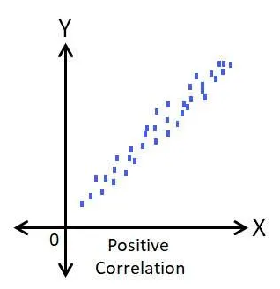
Hypothesis
Infection rate is positively correlated with unemployment rate.
Infection rate is positively correlated with crime reports.
Notes:
My two hypotheses were that infection rate is positively correlated with unemployment rate and with crime reports.
My reasoning was that since rise in covid cases led to national shutdowns, it might have had an effect on employment and if there’s also a relationship between unemployment and crime, crime reports might also have gone up.

Slide 4
Data Source: Crime Rates
Source: Baltimore County Police Department
Based on monthly reported incidents
2020 data: Only reports the most serious offense committed
2021 data: Reports all offenses that took place in an incident
Due to these technical differences, no statistical comparisons can be made between the two years
Notes:
The crime data was collected from the baltimore county police department and has monthly reported incidents. I had to split the data into two separate years because in 2020 only the most serious offense in an incident was reported, whereas starting in 2021 all offenses in an incident were reported and due to this the crime report count was much higher in 2021.

Slide 5
Data Sources: Unemployment
Baltimore County
Source: U.S Bureau of Labor Statistics
Monthly unemployment rate
Collected by survey of sample population
Limitation: Data is not very granular
Maryland
Source: United States Department of Labor
Weekly insured unemployment rate
Limitation: There are unemployed people without unemployment benefits
Notes:
I collected two datasets for unemployment. Baltimore county has monthly data on unemployment rate calculated by using a survey of a sample population. To strengthen my analysis, I also collected weekly insured unemployment rates from the state of maryland dept of labor, however this is limited as it doesn’t represent unemployed people who aren’t collecting unemployment benefits.

Slide 6
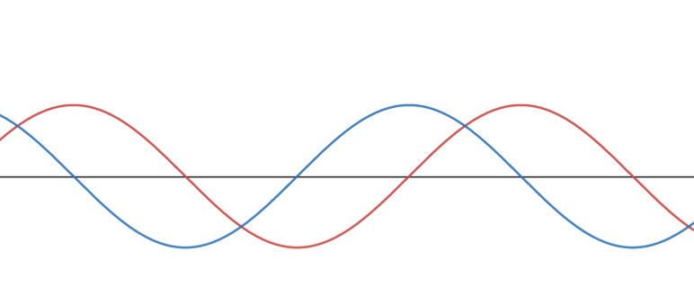
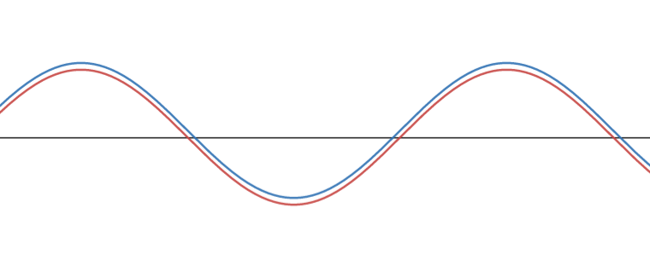
Methodology
Pearson correlation
Measures linear relationship between two variables between -1 and 1
Cross correlation
Measures linear relationship with a displacement of one series relative to the other
Notes:
I used a Pearson correlation to determine if there was any linear relationship between infection rate, crime reports and unemployment rate. After doing this I did multiple cross correlations, which measures the relationship with a displacement, to find an optimal time lag and see if there was a stronger relationship given this lag.

Slide 7
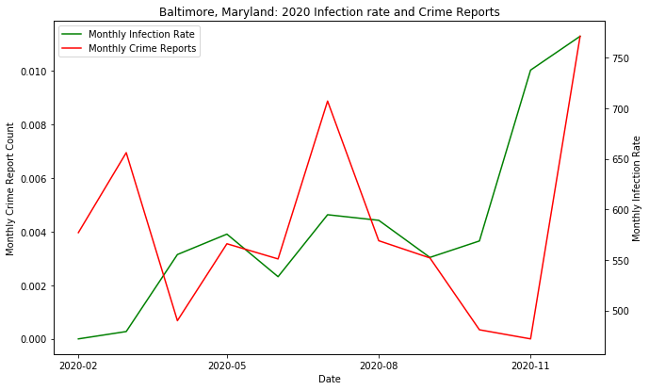
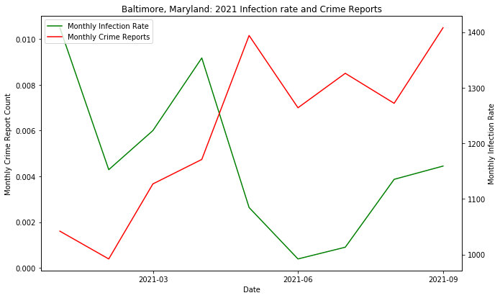
Results: Infection Rate & Crime Reports
Correlation coefficient =0.21
P-value = 0.52
Correlation coefficient = -0.57
P-value = 0.10
Notes:
First I looked at infection rate and crime reports in 2020 and 2021 and didn’t find anything statistically significant. The relationship between crime reports and unemployment rate also didn’t yield anything significant. Due to the lack of data points I couldn’t do a meaningful cross correlation and I believe more granular data would be needed to understand the relationship better.

Slide 8
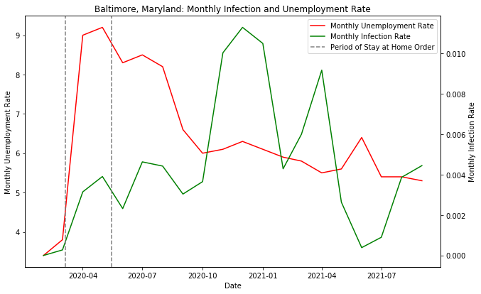
Results: Infection & Unemployment Rate in Baltimore County
Correlation Coefficient = 0.12
P-Value = 0.62
Notes:
Next I looked at infection rate and unemployment rate in baltimore county. I again found nothing statistically significant, but I noticed that the major jump in unemployment rate came in April, one month after the state’s stay at home order signifying that this could be a greater predictor of unemployment rate. This is further exemplified by the downward trend in unemployment rate after the initial order ended even with the variation in infection rate.

Slide 9
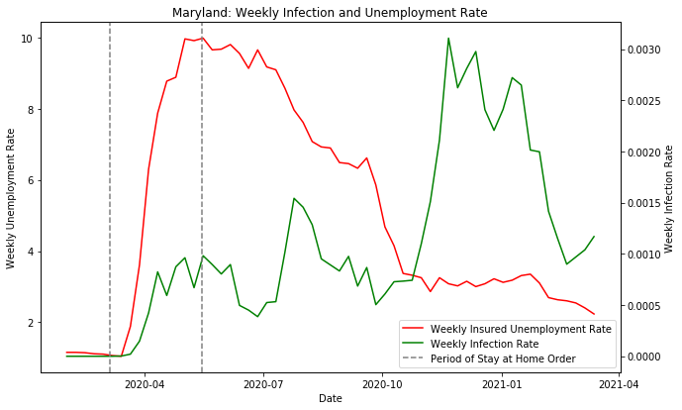
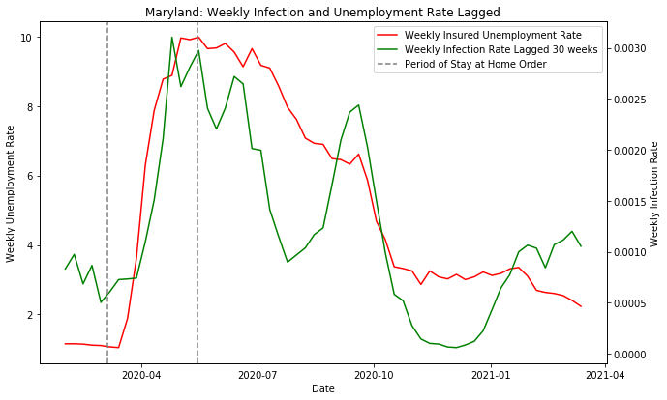
Results: Infection & Unemployment Rate in Maryland
Applying lag of -30 weeks
Correlation Coefficient before lag: -0.14
P-Value before lag: 0.28
Correlation Coefficient after lag: 0.79
P-Value after lag: <.001
Notes:
Due to this lack of correlation I looked at Maryland unemployment rates. Even at a weekly level l found no significant results and when I applied cross correlation unemployment rate correlated with infection rate with an optimal lag time of ~7 months. Even though this resulted in a significant and strong correlation, the qualitative interpretation of this isn’t meaningful and the rises in rates can be better explained through other variables.

Slide 10
Discussion of Results
Rejection of both hypotheses
No statistically significant results for any of the three variables
Shut down dates seem to be better predictors of unemployment rate than infection rate itself
While cross correlation yielded statistically meaningful correlations, wasn’t meaningful in a qualitative sense
Crime reports not granular enough for analysis
Additionally, outside factors would need consideration (Protests, Stay at Home Order, Seasonality)
Notes:
I ended up rejecting both of my initial hypotheses, there was no statistically significant correlation between covid, crime and unemployment. I also found that stay at home order seemed to be a better predictor of high unemployment rate than infection rate itself. While my cross correlation yielded statistically meaningful correlations, it wasn’t meaningful in a qualitative sense.

Slide 11
Limitations
Unemployment data collection
Difficult to get publicly available granular data for unemployment
Weekly data was not representative of all those that are unemployed
Crime Reporting
Only able to get monthly data for crime reports
Unable to make comparisons across 2020 and 2021 due to reporting changes
Unable to get a meaningful result from cross correlation
Notes:
The biggest challenge for my analysis was the limited number of datapoints that I had. For instance, due to changes in reporting the lowest granularity I was able to obtain for crime data was monthly, and I couldn’t make comparisons between years. Similarly for unemployment, I was able to get weekly data but it was only for those who were insured.

Slide 12
Future Work
Gathering more data on government shutdowns
Investigating this as a confounding factor for rises in unemployment rate
Looking into hospitalization rates
Hospitalization rates could potentially influence shutdowns more so than infection rate
More granular crime data
Looking into the relationship between infection rate, unemployment rate, and crime data on a daily level
Notes:
To expand my analysis, I would gather more data on government shutdowns to investigate this as a confounding factor for rise in unemployment rates. I would also see if hospitalization rates influence shut downs and unemployment more so than infection rate.Finally I would perform my analysis with crime reporting data in future years with the more accurate reporting methodology.

